Slide 1
Phoswich GATE
Bill Worstell
CapeSym
1/4/2022

Slide 2
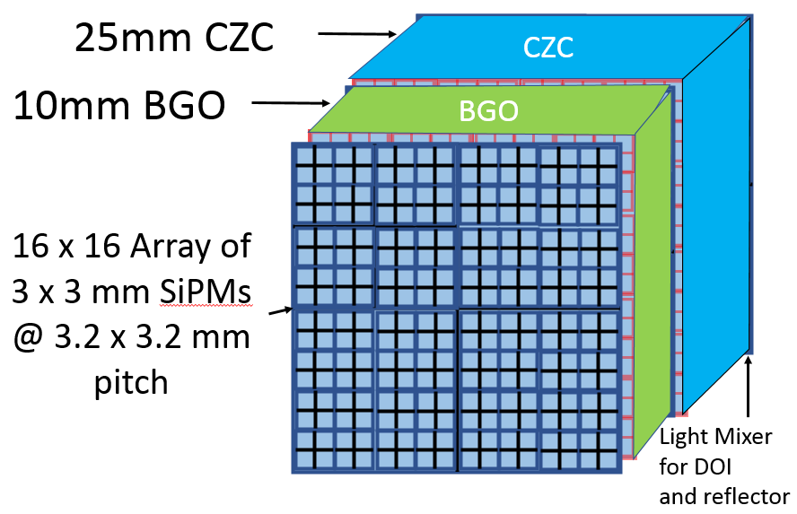

Slide 4
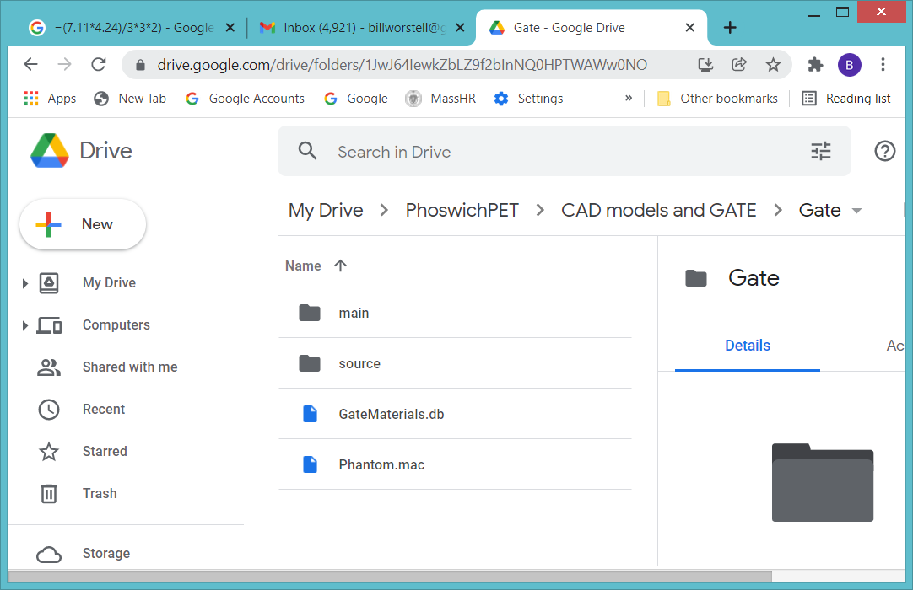

Slide 5
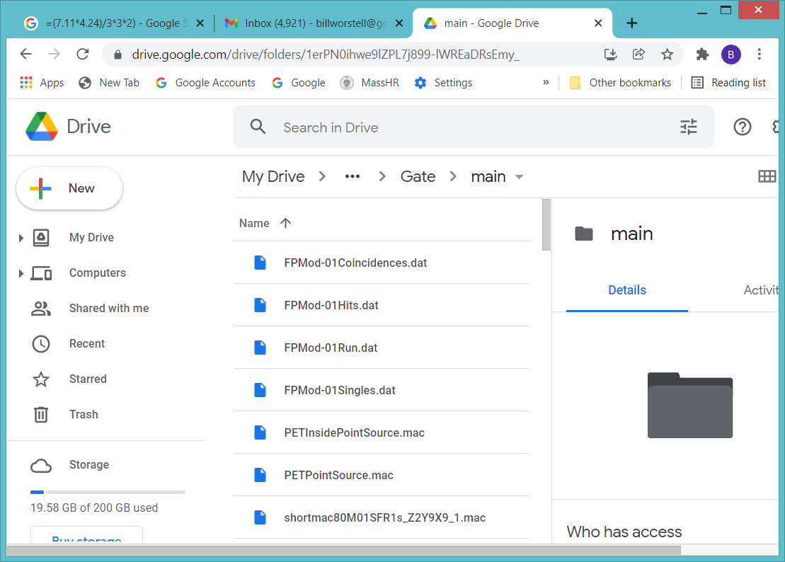

Slide 6
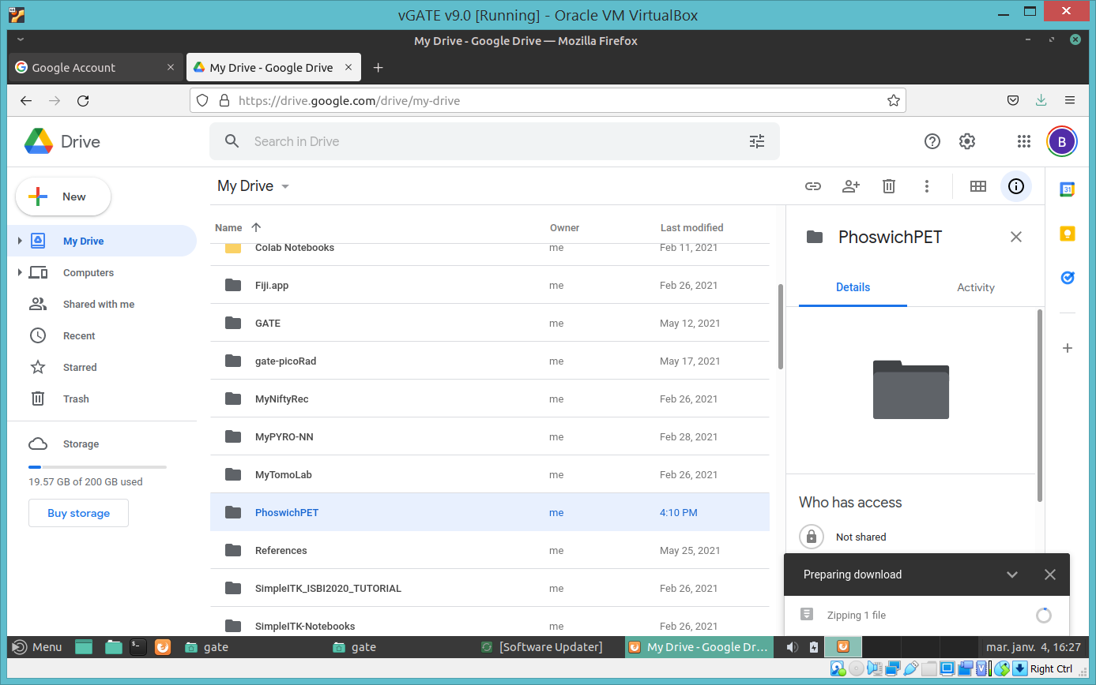

Slide 7
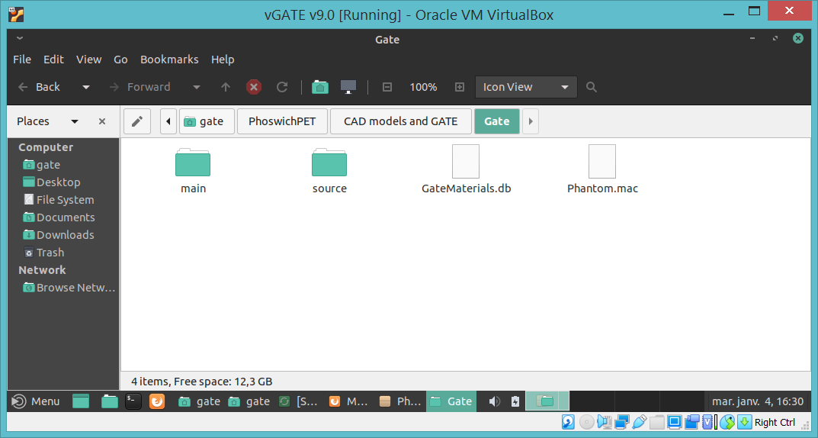

Slide 8
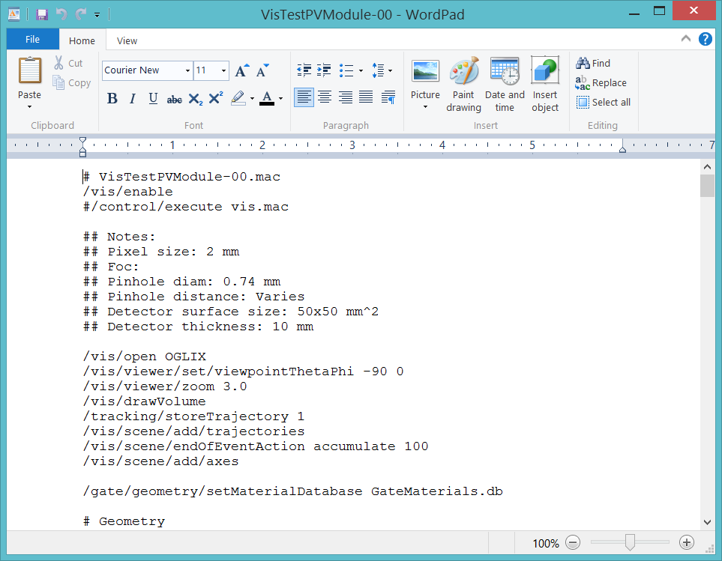

Slide 9
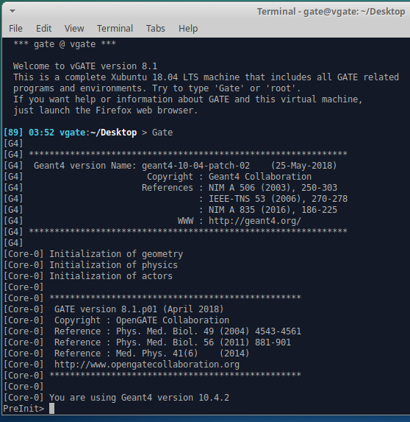
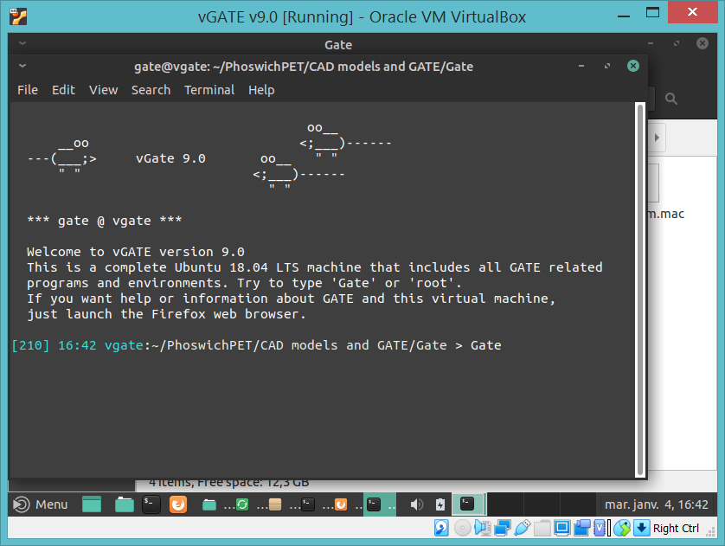
Open vGATE terminal and launch GATE
/control/execute main/VisTestPETModule.mac

Slide 10
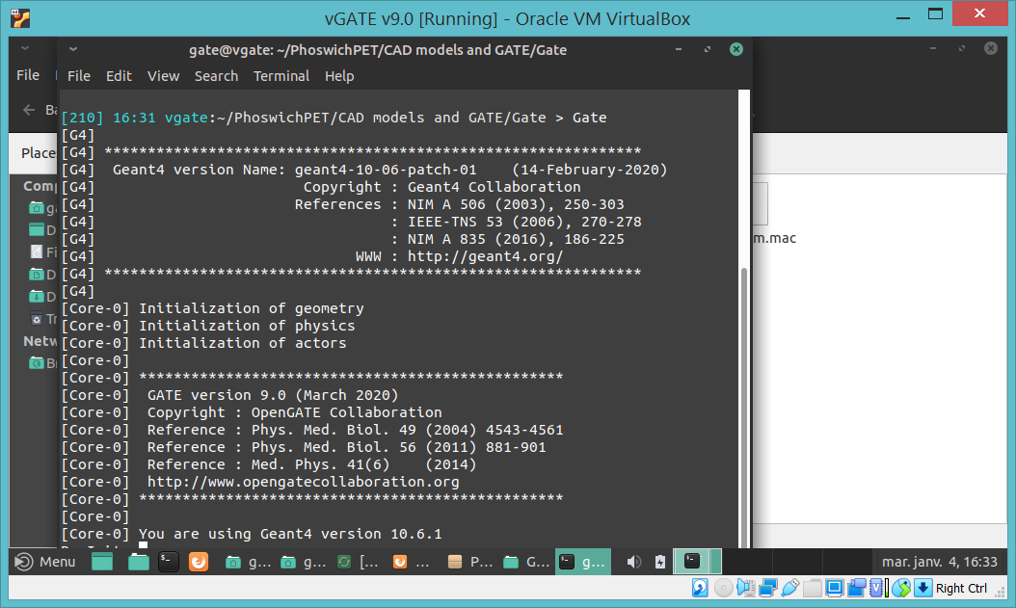
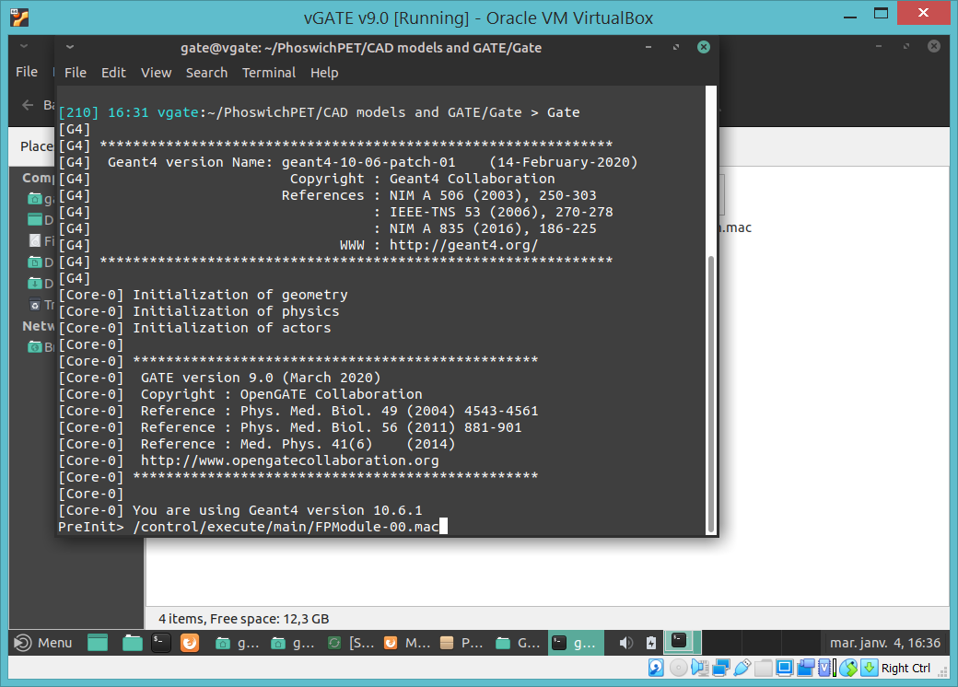
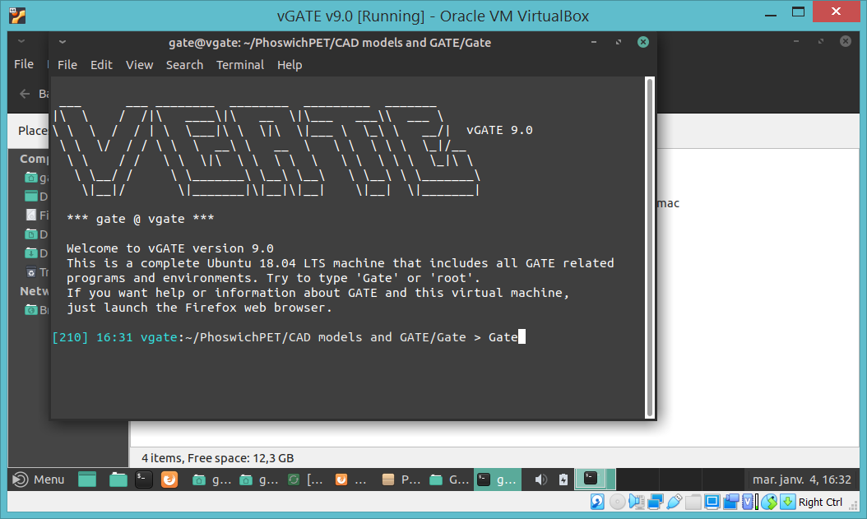
Open vGATE terminal and launch GATE

Slide 11
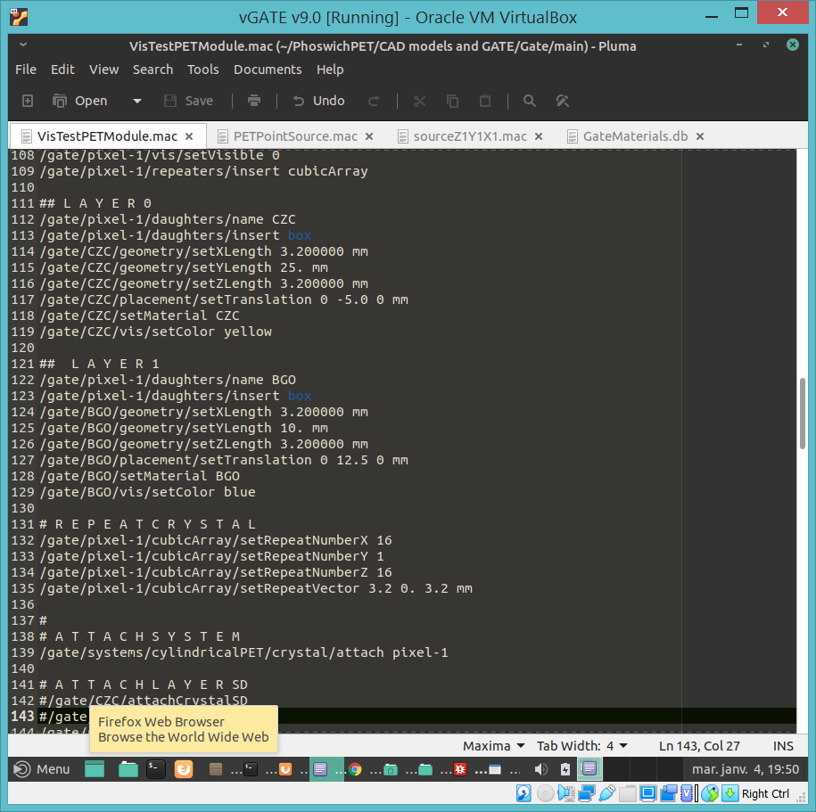
VisTestPETModule.mac
GateMaterials.db

Slide 12
25mm CZC
CZC
10mm BGO
BGO
16 x 16 Array of
3 x 3 mm SiPMs
@ 3.2 x 3.2 mm pitch
Light Mixer for DOI
and reflector

Slide 14
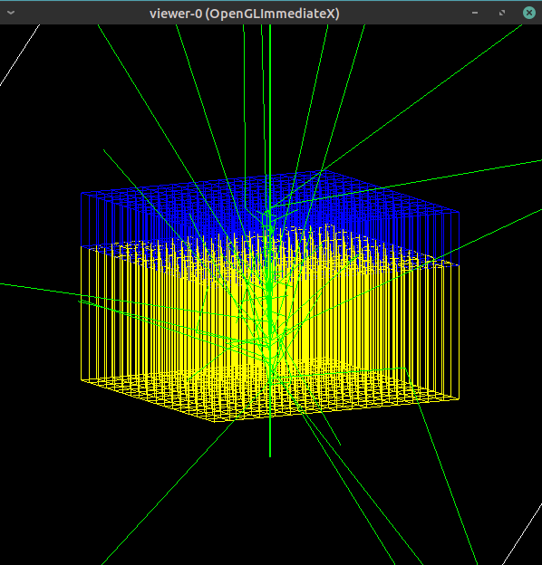
25mm CZC
10mm BGO
Incident from
Center of CZC
Side of block

Slide 15
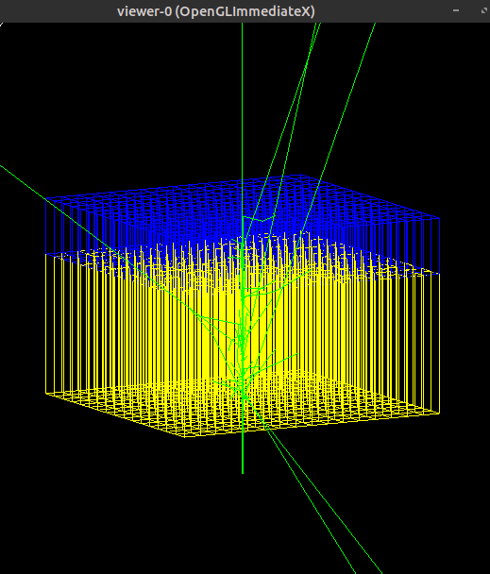
25mm LYSO
10mm BGO
Incident from
Center of LYSO
Side of block

Slide 16
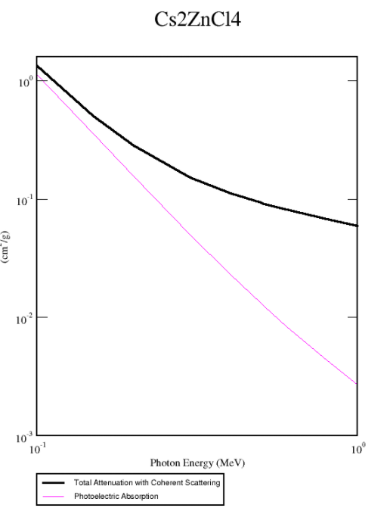
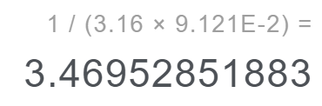

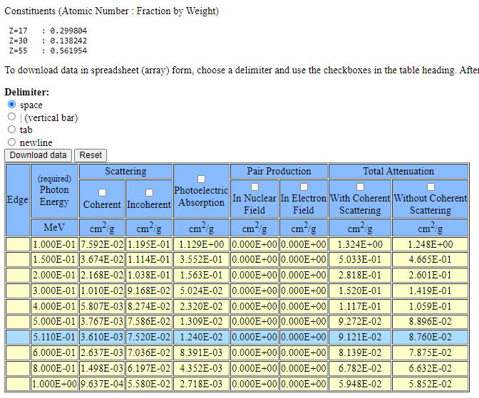
ρ = 3.16 g/cm^3 -> Attenuation Length cm. @ 511keV = 3.47 cm
Photocapture Fraction @ 511keV
= 14.2 %

Slide 17
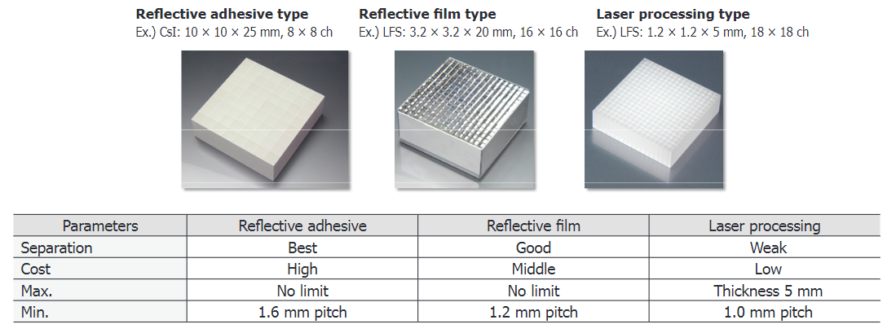
MPPC Module for PET Hamamatsu Technical Note
3.2 x 3.2 x L mm CZC, 16 x 16 array
3.2 x 3.2 x T mm BGO, 16 x 16 array
Reflective film or adhesive type
www.hamamatsu.com/resources/pdf/ssd/pet_module_kacc9009e.pdf

